Slide 1
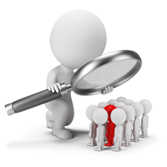
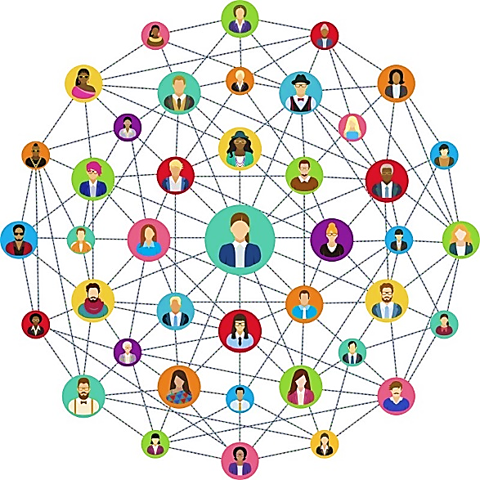
Learning Social Circles in Networks

Slide 2

Contents
Task's description
Data
Submission requirements
Mathematical background
Implementation
Inferences

Slide 3
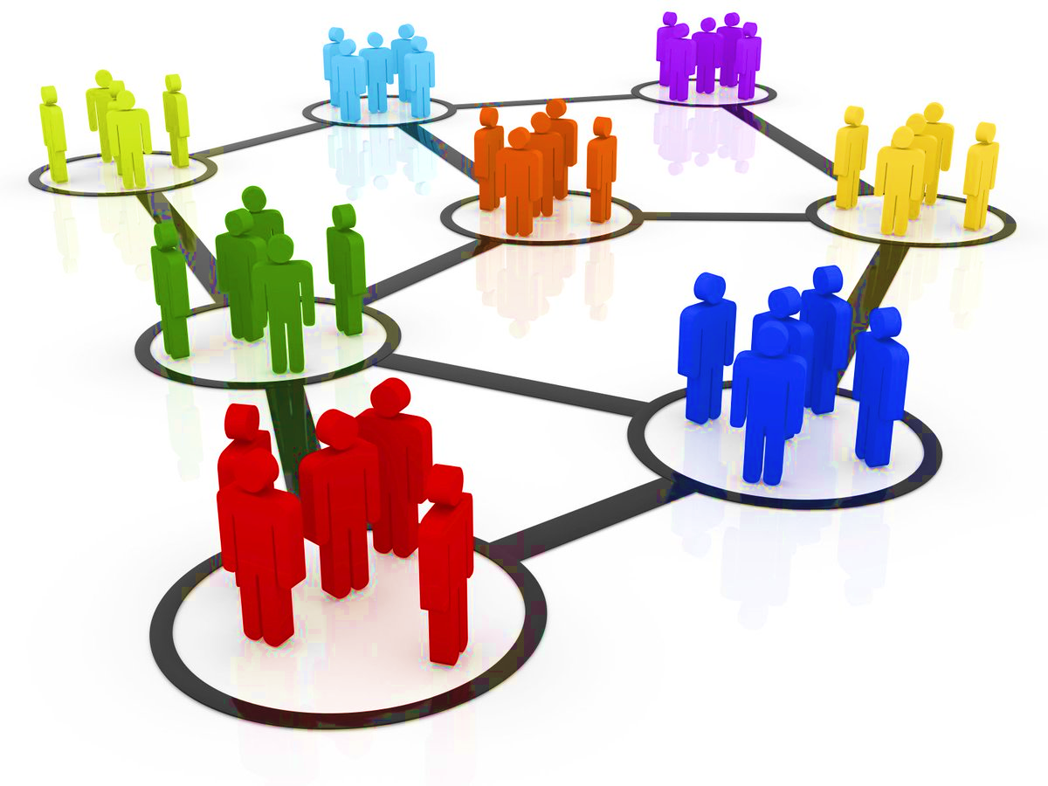
Description
The goal: Automatically categorize the friends into social circles

Slide 4
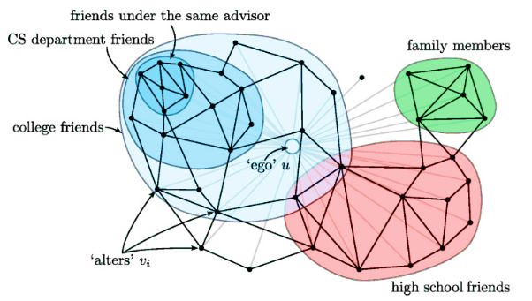
Description
The goal: find nested as well as overlapping communities/clusters in ego-network

Slide 5

Data

Slide 6

Data
User: Target individual whose network is the focus of the task (ego)
Friend: Friend of the target individual (user) that needs to be placed into a circle

Slide 7
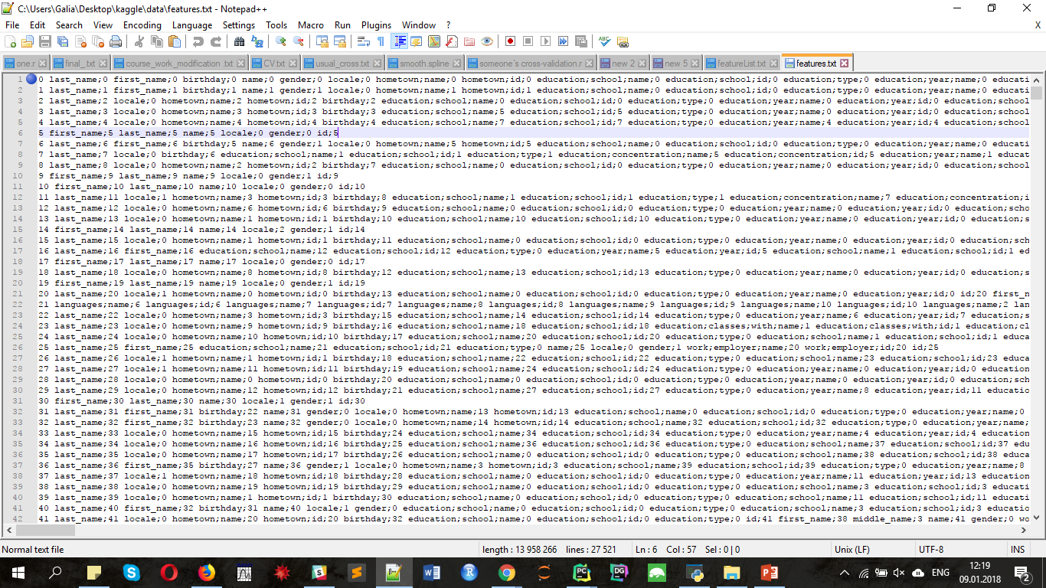
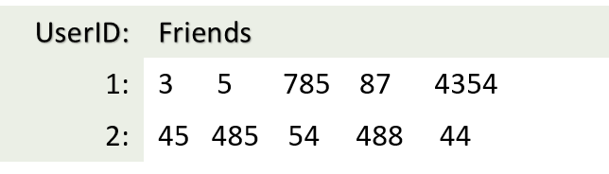
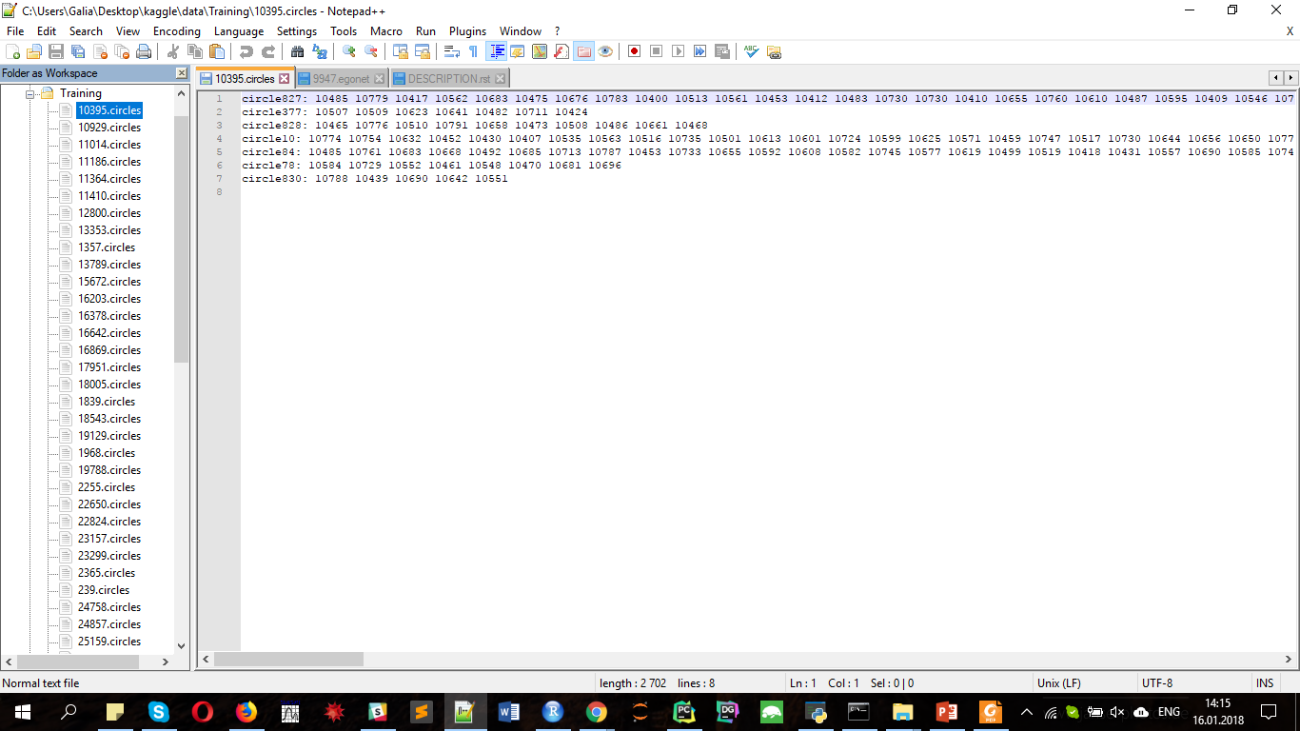
Data
features: features for all user
egonets: files userID.egonet with the ego-network of a single Facebook user
training: files user.circles with human-labeled circles provided by a user

Slide 8
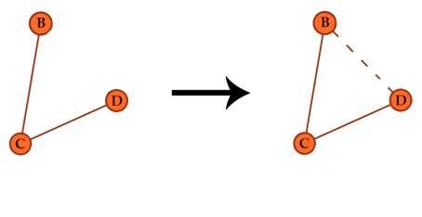
Triadic Closure
If C is connected to B and D. Are B and D also connected?
If they are, then this set of nodes has triadic closure.
The more triadic closure within a subgroup of nodes –
the more likely they belong to a cluster

Slide 9
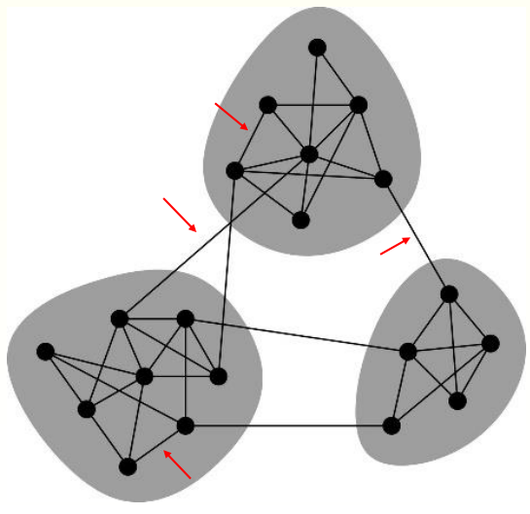
Strong and Weak Ties
Weak ties (also called bridges) are those without triadic closure for all or most adjacent connections
Strong ties have triadic closure on most of their adjacent connections

Slide 10
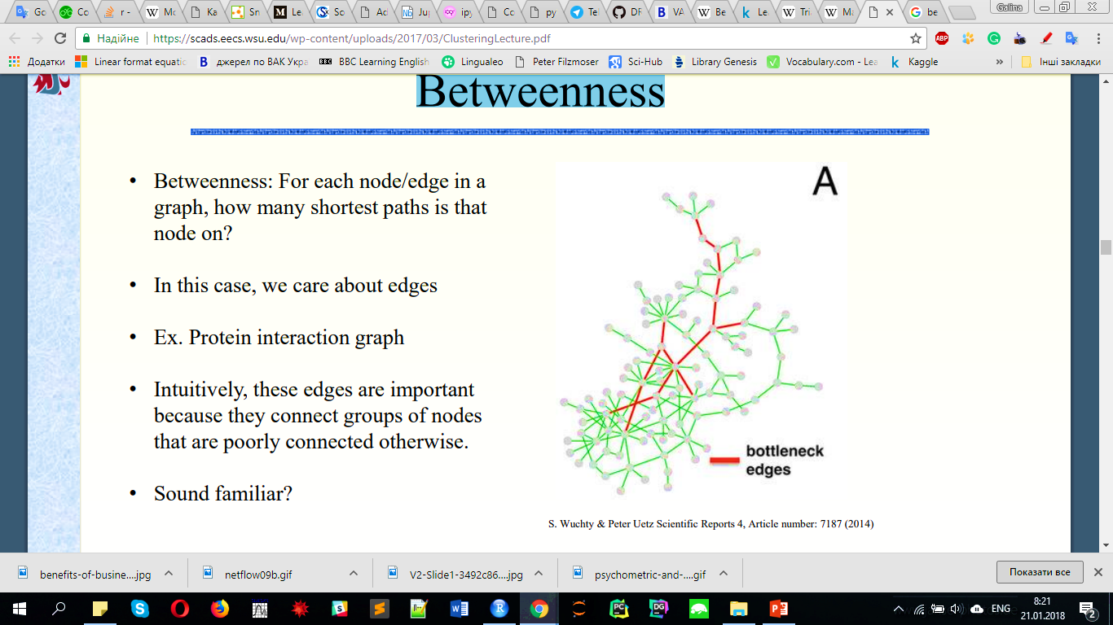
Betweenness
Betweenness:
For each node/edge in a graph, how many shortest paths is that node on?
Intuitively, these edges are important because they connect groups of nodes that are poorly connected otherwise

Slide 11
Girvan-Newman Algorithm (edge-betweenness)
Uses edge betweenness as a measure of weak-ties
Iteratively removes high betweenness edges to find clusters
Procedure:
The betweenness of all existing edges in the network is calculated first.
The edge with the highest betweenness is removed.
The betweenness of all edges affected by the removal is recalculated.
Steps 2 and 3 are repeated until no edges remain.

Slide 12
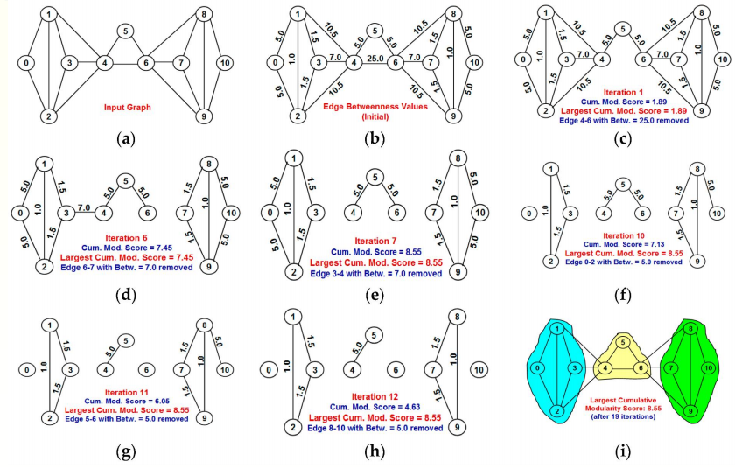
Girvan-Newman Algorithm (edge-betweenness)
Uses edge betweenness as a measure of weak-ties
Iteratively removes high betweenness edges to find clusters
Procedure:
The betweenness of all existing edges in the network is calculated first.
The edge with the highest betweenness is removed.
The betweenness of all edges affected by the removal is recalculated.
Steps 2 and 3 are repeated until no edges remain.

Slide 13
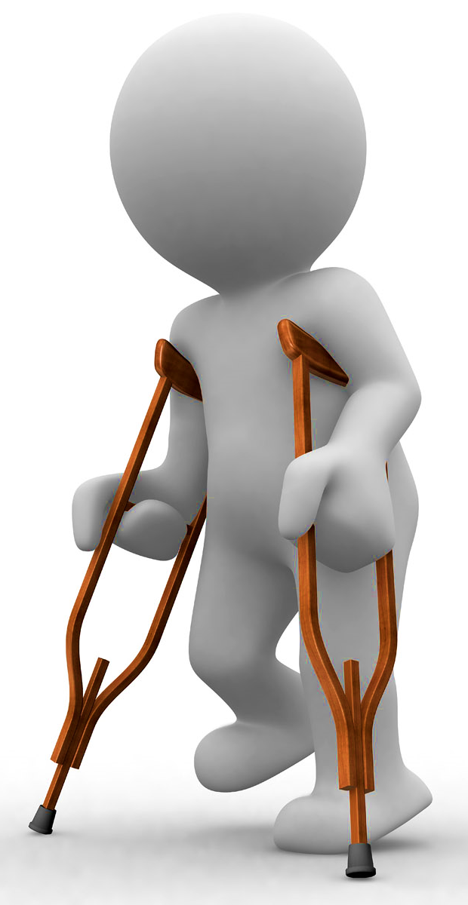
Girvan-Newman Algorithm (edge-betweenness)
Strengths:
Intuitive
Number of clusters is based on graph structure (not predefined)
Weaknesses:
Relatively slow (requires BFS O(|V|+|E|) at every step to calculate betweenness)
If two communities are connected by more than one edge, then there is no guarantee that all of these edges will have high betweenness

Slide 14
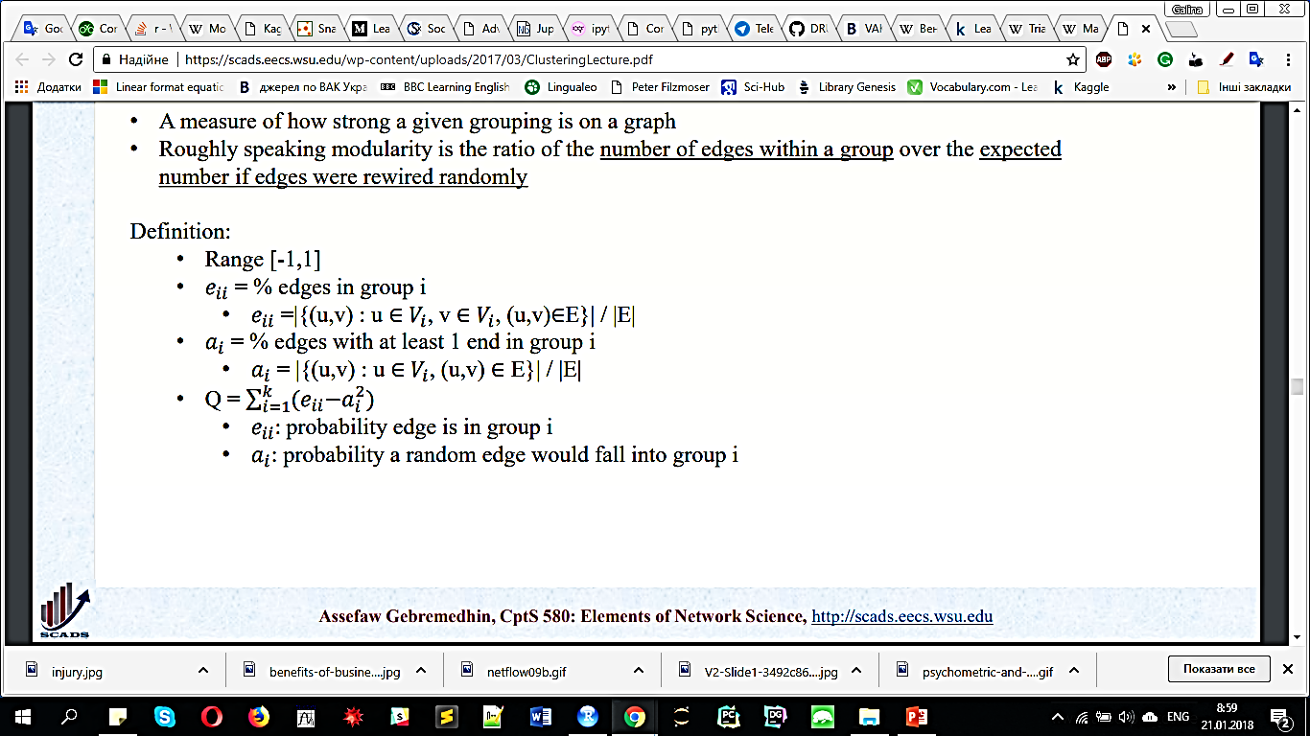
Modularity
A measure of how strong a given grouping is on a graph
Roughly speaking modularity is the ratio of the number of edges within a group over the expected number if edges were rewired randomly

Slide 15
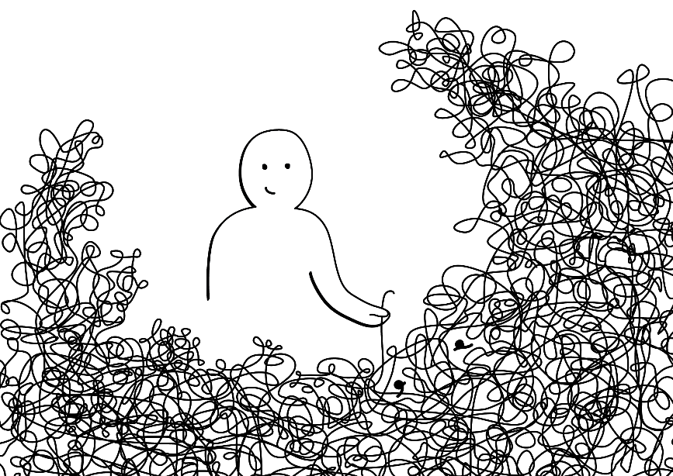
Modularity Maximization
Problem:
Find set of subsets of V(G) to maximize this value
This is the gold standard for clusters
But… modularity is NP-hard to optimize
Exact calculation is cluster_optimal in igraph
This is going to be VERY slow, however (obviously)
Several good approximations exist

Slide 16
Louvain
A local greedy optimization of modularity
Procedure:
Select an arbitrary node, n in G
Choose the neighbor of n that maximizes the modularity function.
Repeat 1-2 until all nodes have been clustered to a neighbor
Now generate a new graph, where each community merges into a single node.
Repeat steps 1-4 on the new graph until modularity does not increase.

Slide 17
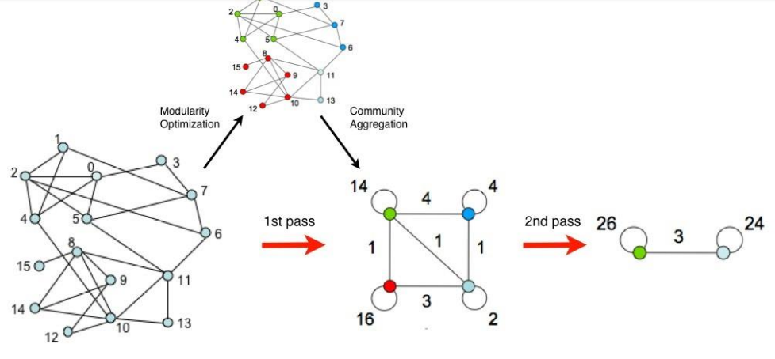
Louvain

Slide 18

Louvain
Strengths:
• In practice produces high modularity clusters
(near optimal performance in may cases)
• Fast O(|V| + log(|V|))
Weaknesses:
• Approximate method, no guarantee of global
maximum of modularity
• Sometimes fails to find smaller clusters

Slide 19
Fast greedy
The operation of the algorithm involves finding the changes in Q that would result from the amalgamation of each pair of communities, choosing the largest of them, and performing the corresponding amalgamation.

Slide 20
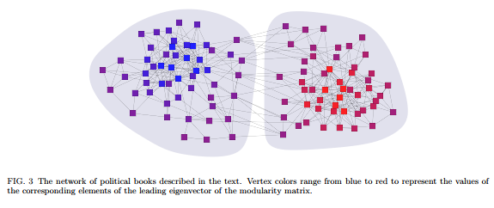
Leading eigenvectors
find the eigenvector corresponding to the most positive eigenvalue of the modularity matrix and divide the network into two groups according to the signs of the elements of this vector

Slide 21
Label Propagation
Labels are shard among neighboring nodes until convergence
Procedure:
Initialize the labels for all nodes in the network
Set t = 1
Arrange the nodes in the network in a random order
For each x ∈ X chosen in that specific order, set the label of x to the label of the largest number of its neighbors.
If every node has a label that the maximum number of their neighbors have, then stop.
Else, set t = t + 1 and go back to step.

Slide 22
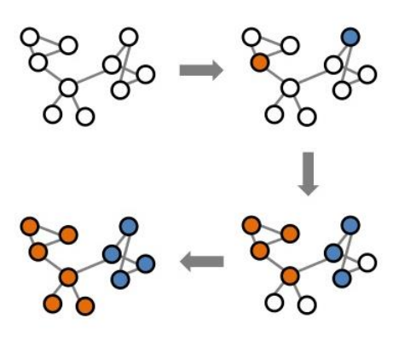
Label Propagation

Slide 23
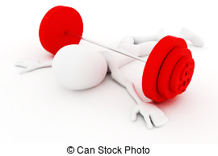
Label Propagation
Strengths:
• In practice, finds high modularity clusters
• Fast O(|V| + |E|)
Weaknesses:
Solutions are not unique (typically the algorithm is run several times and solutions are aggregated)
Random ordering can mean two clusters are merged into one
Again, approximate, so no guarantees of optimality

Slide 24
Label Propagation
Strengths:
• In practice, finds high modularity clusters
• Fast O(|V| + |E|)
Weaknesses:
Solutions are not unique (typically the algorithm is run several times and solutions are aggregated)
Random ordering can mean two clusters are merged into one
Again, approximate, so no guarantees of optimality

Slide 25
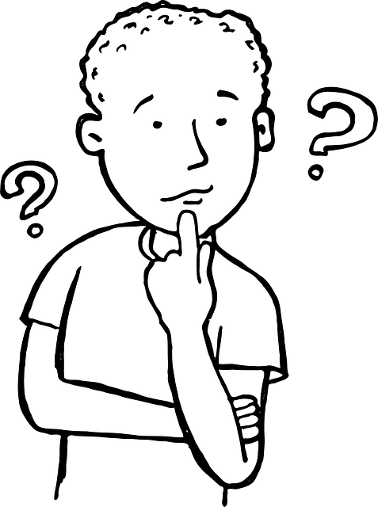
Results of modularity-based clustering
Edge-betweenness
Propagating Labels
Louvain
Walktrap
Fast Greedy
Spin Glass
Leading Eigenvectors
Info map

Slide 26
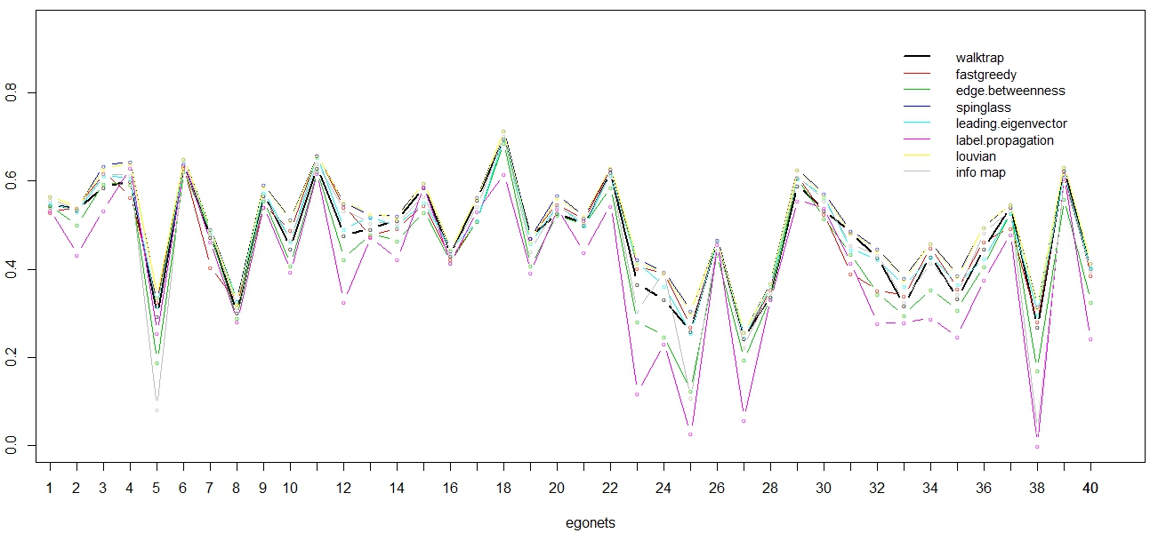
Results of modularity-based clustering

Slide 27
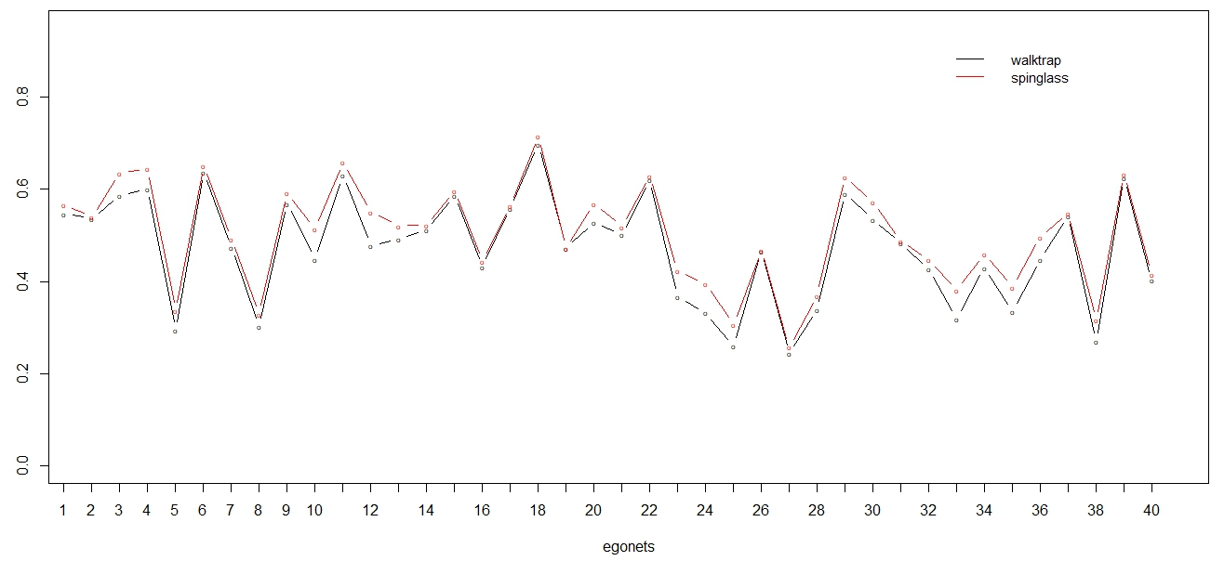
Walktrap & Spin glass

Slide 28
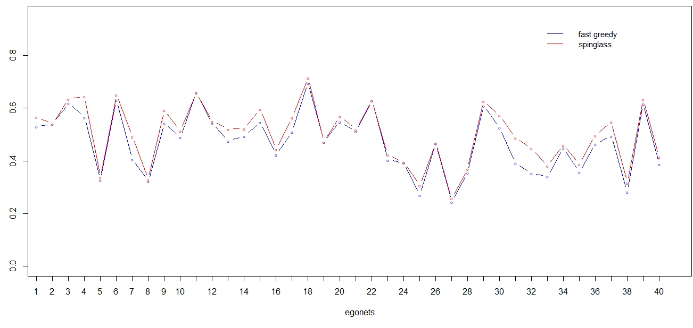
Fast greedy & Spin glass

Slide 29
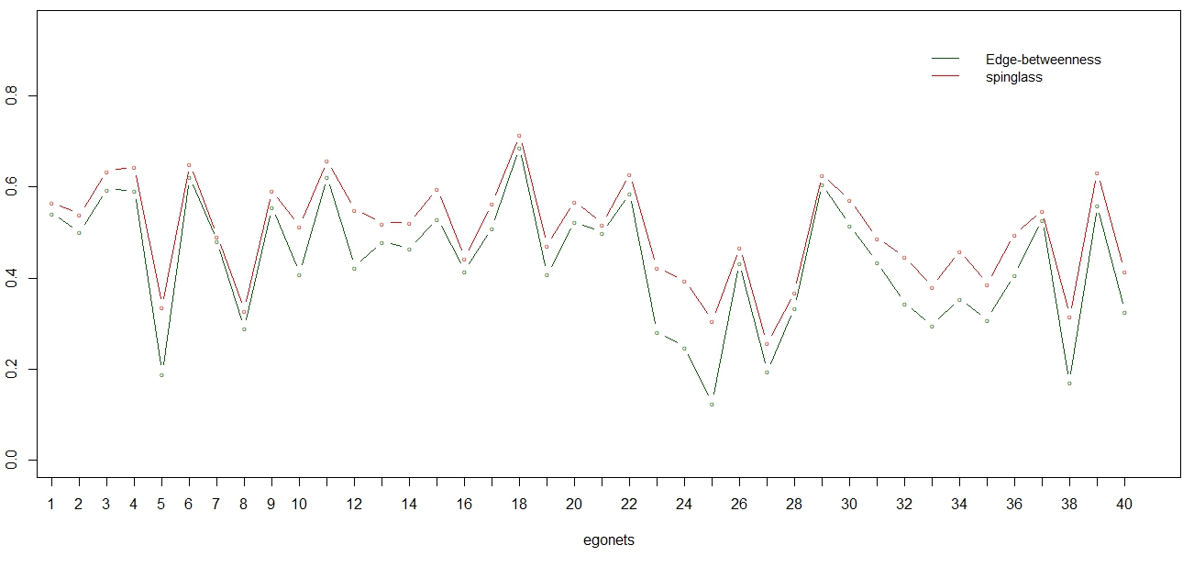
Edge-betweenness & Spin glass

Slide 30
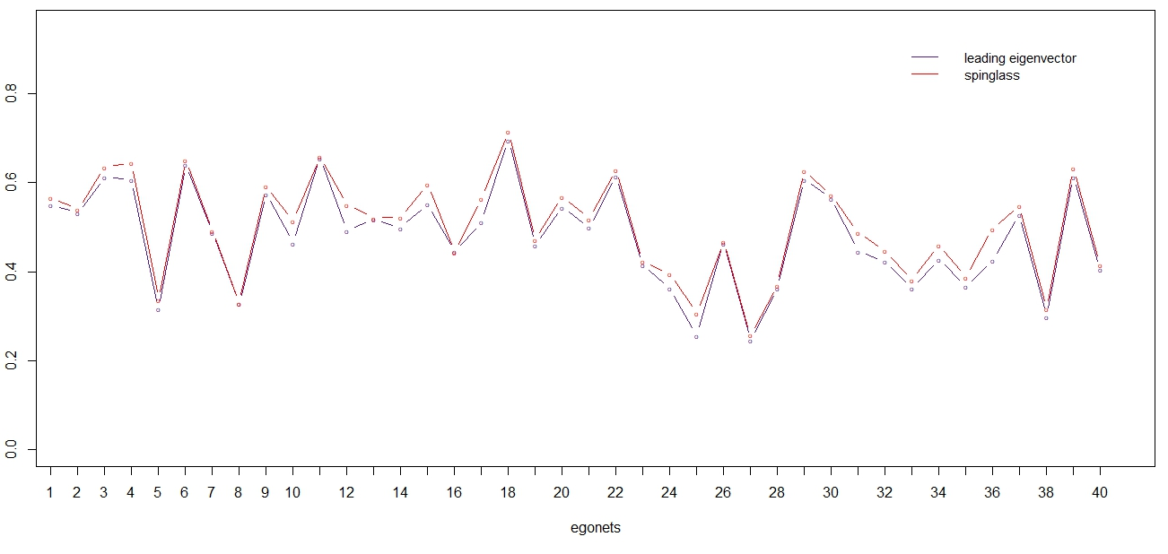
Leading eigenvectors & Spin glass

Slide 31
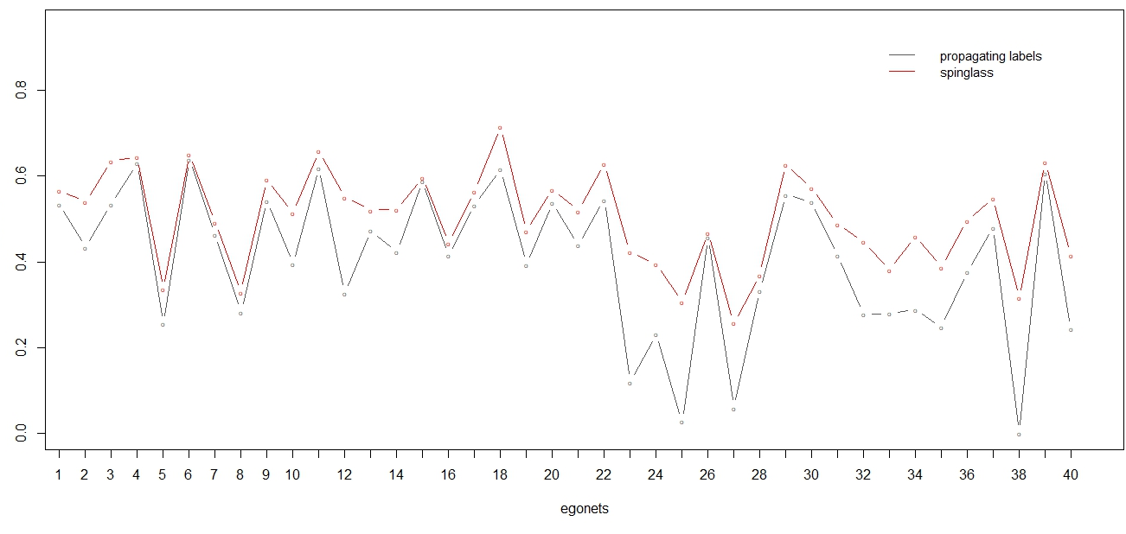
Propagating Labels & Spin glass

Slide 32
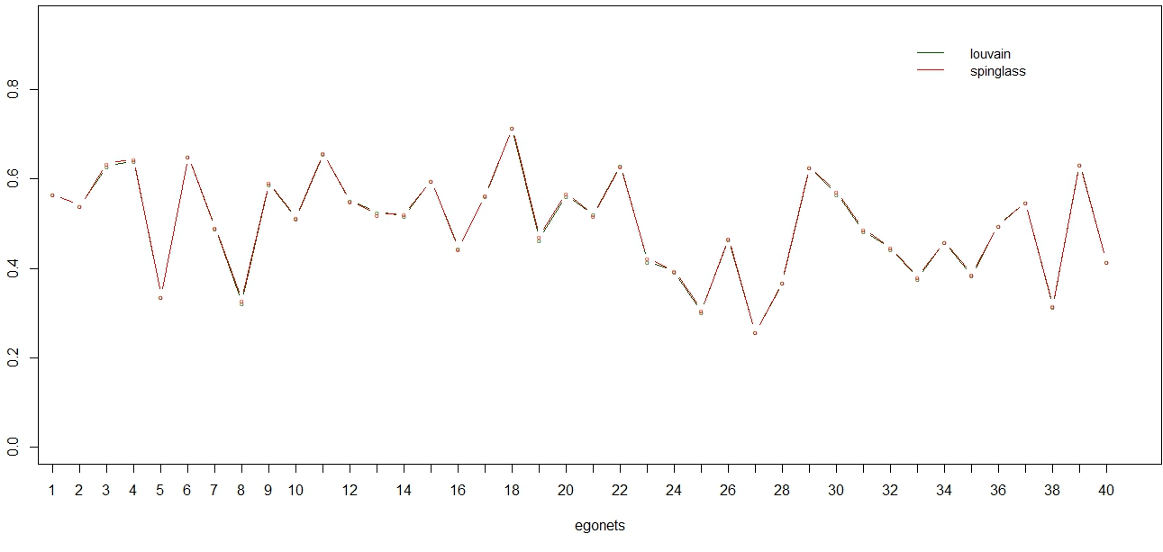
Louvain & Spin glass

Slide 33
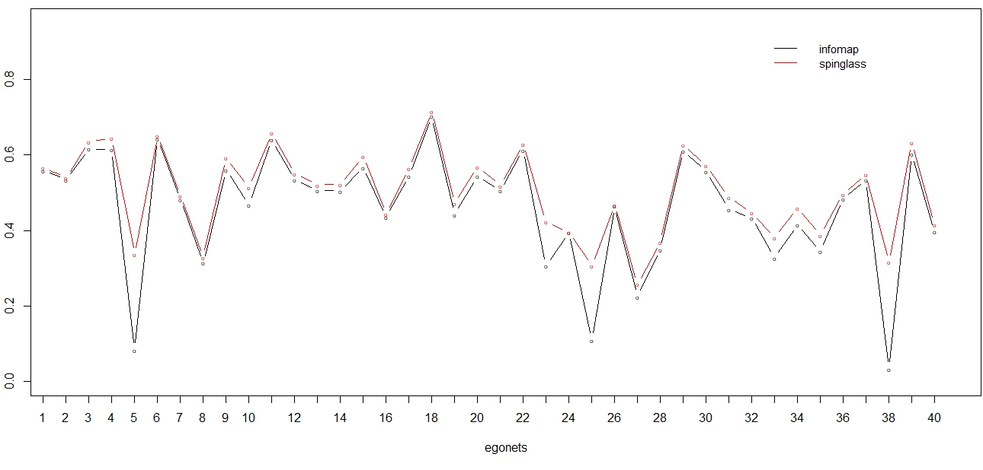
Info map & Spin glass

Slide 34





Evaluating with 'edit distance'
Each of the following operations costs one edit:
Add a user to an existing circle
Create a circle with one user
Remove a user from a circle
Delete a circle with one user

Slide 35
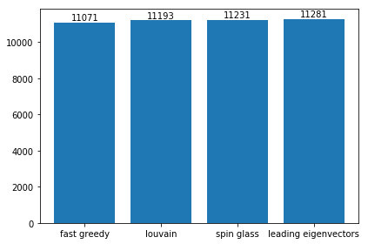
Evaluating with 'edit distance'

Slide 36
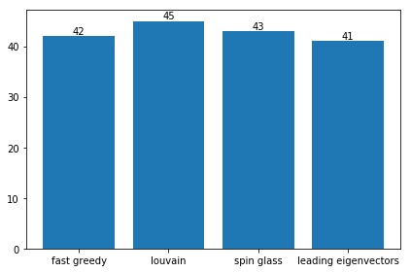
The brief analysis

Slide 37
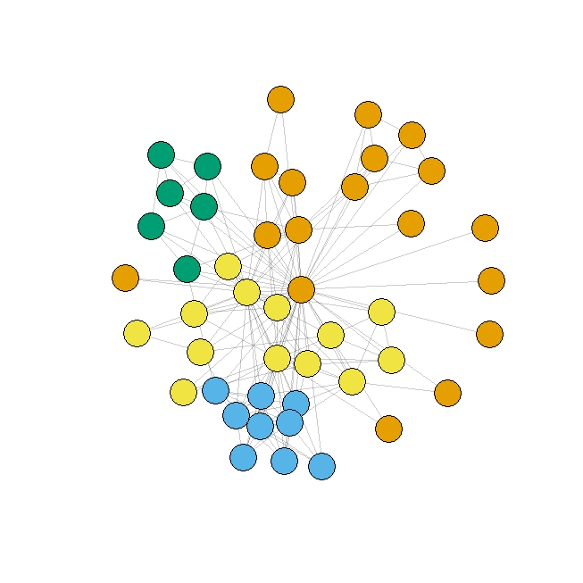
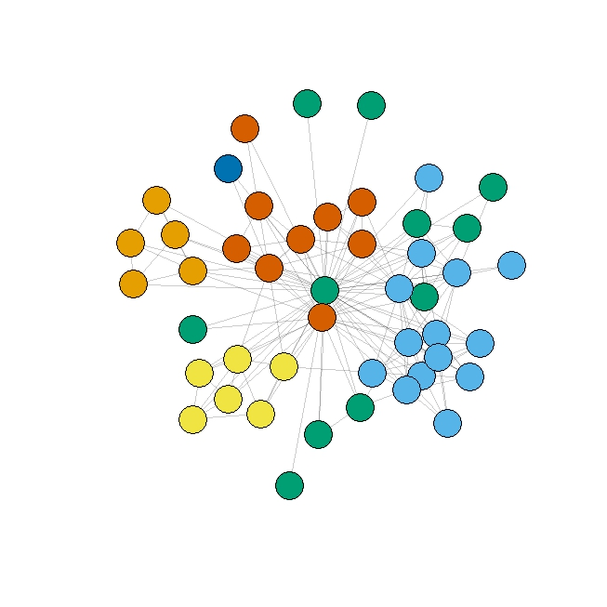
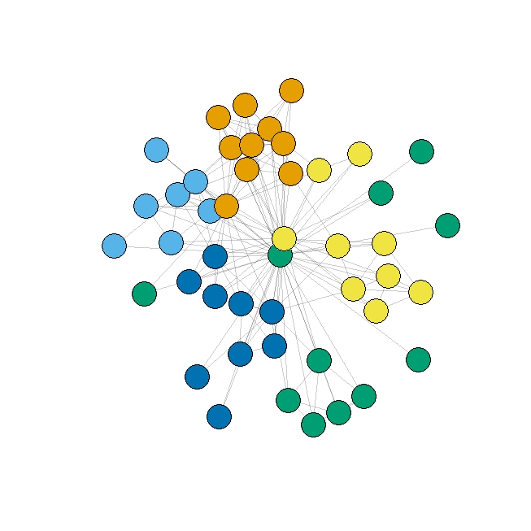
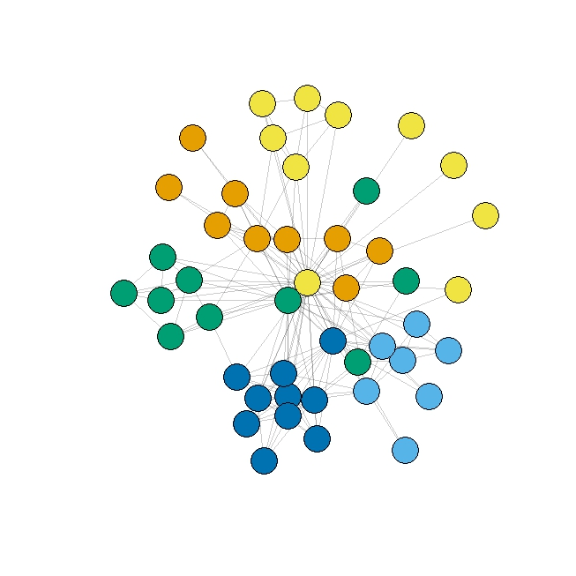
The brief analysis
Fast
greedy
Leading
eigenvectors
Spin glass
Louvain

Slide 38
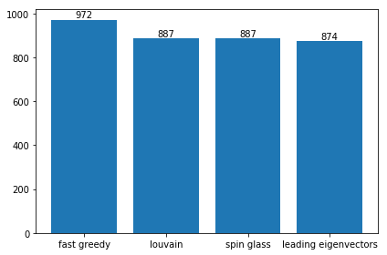
The brief analysis

Slide 39

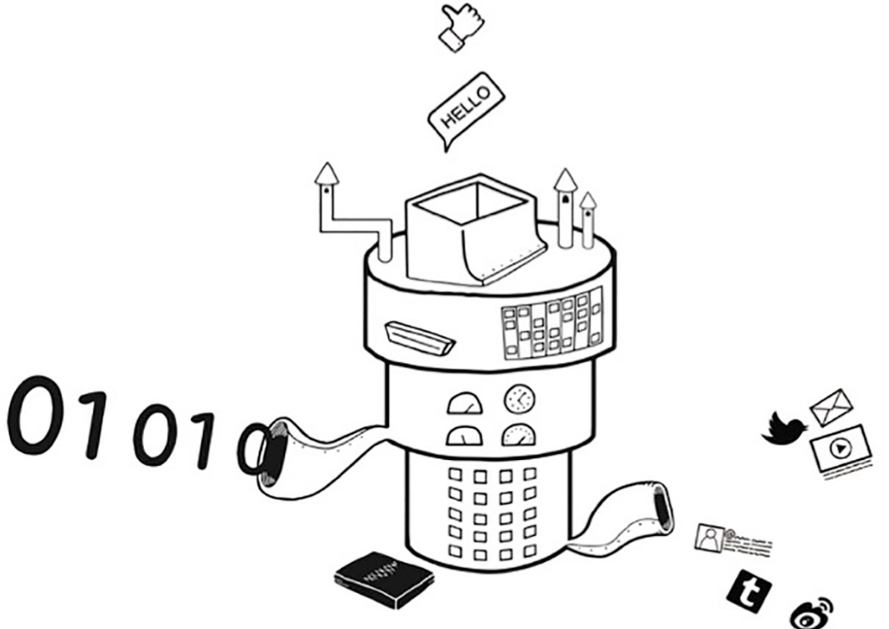
Test sample`s results

Slide 40
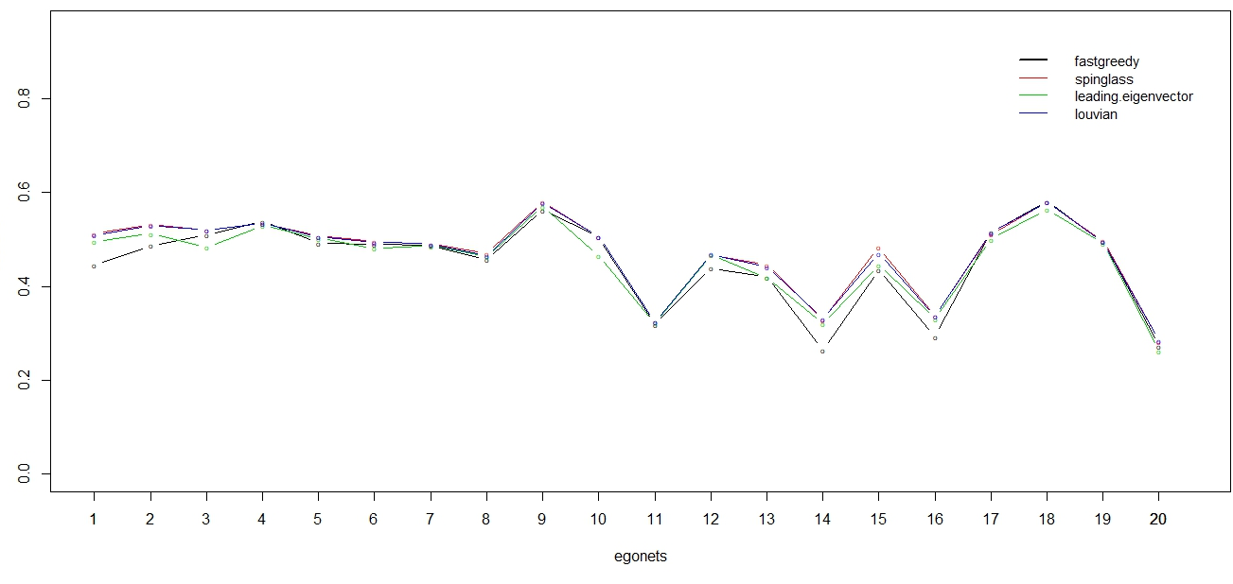
Modularity-based clustering test result

Slide 41
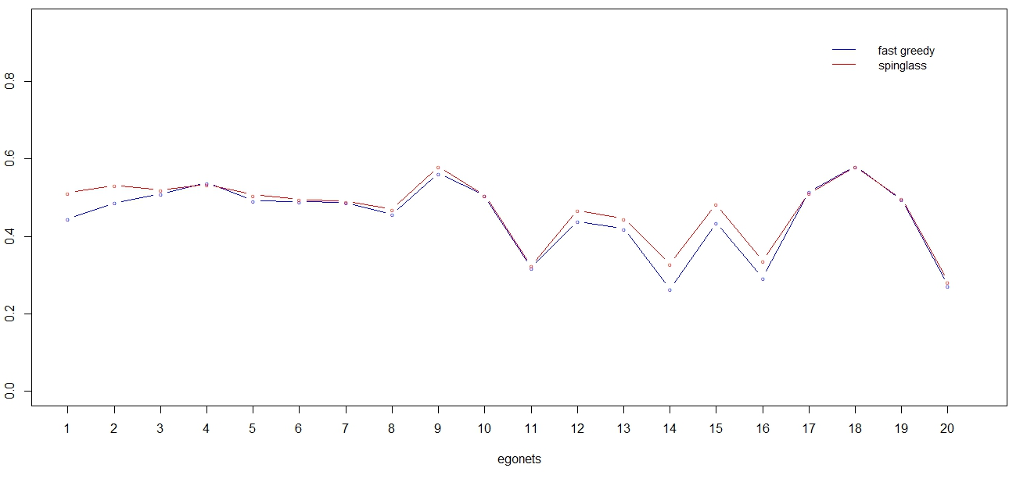
Fast greedy & Spin glass

Slide 42
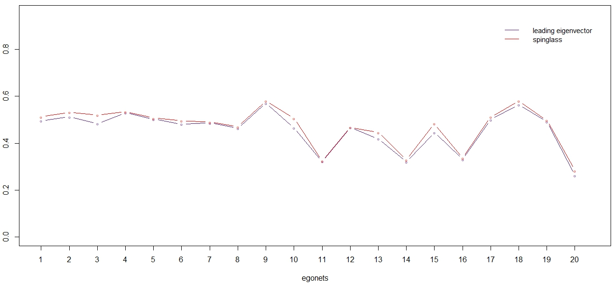
Leading eigenvectors & Spin glass

Slide 43
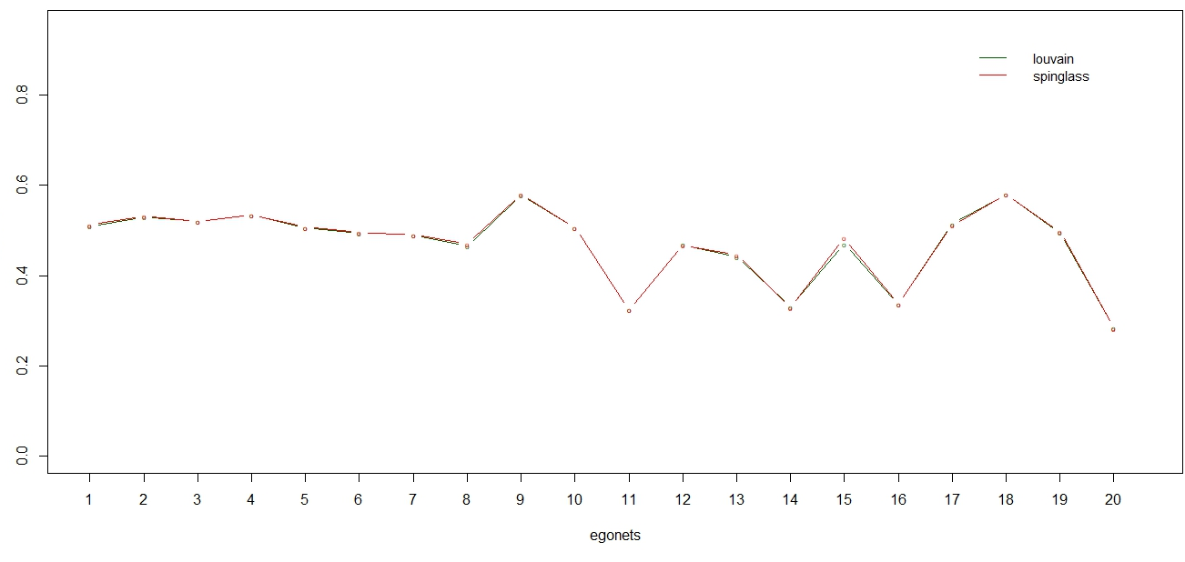
Louvain & Spin glass

Slide 44
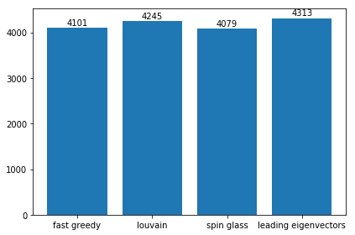
Evaluating with 'edit distance'

Slide 45
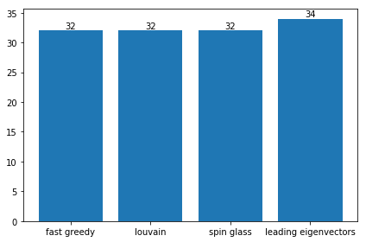
Brief analysis

Slide 46
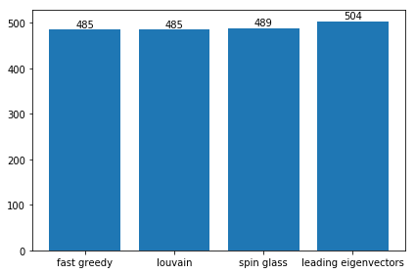
Brief analysis

Slide 47
The Literature and Resources
McAuley J. Learning to Discover Social Circles in Ego Networks [Електронний ресурс] / J. McAuley, J. Leskovec – Режим доступу до ресурсу: http://i.stanford.edu/~julian/pdfs/nips2012.pdf.
Pons P. Finding community structure in very large networks [Електронний ресурс] / P. Pons, M. Latapy – Режим доступу до ресурсу: https://www-complexnetworks.lip6.fr/~latapy/Publis/communities.pdf.
Clauset A. Finding community structure in very large networks [Електронний ресурс] / A. Clauset, M. E. Newman, C. Moore – Режим доступу до ресурсу: http://ece-research.unm.edu/ifis/papers/community-moore.pdf.
Newman M. E. Finding community structure in networks using the eigenvectors of matrices [Електронний ресурс] / Newman – Режим доступу до ресурсу: https://arxiv.org/pdf/physics/0605087.pdf.

Slide 48


